Slide 1


Noida Institute of Engineering and Technology, Greater Noida
Introduction and Basic Information about Indian Constitution
Unit: 1
Subject Name:
Constitution of India, Law and Engineering
Course Details (Ex: B Tech 5th sem)

Slide 2

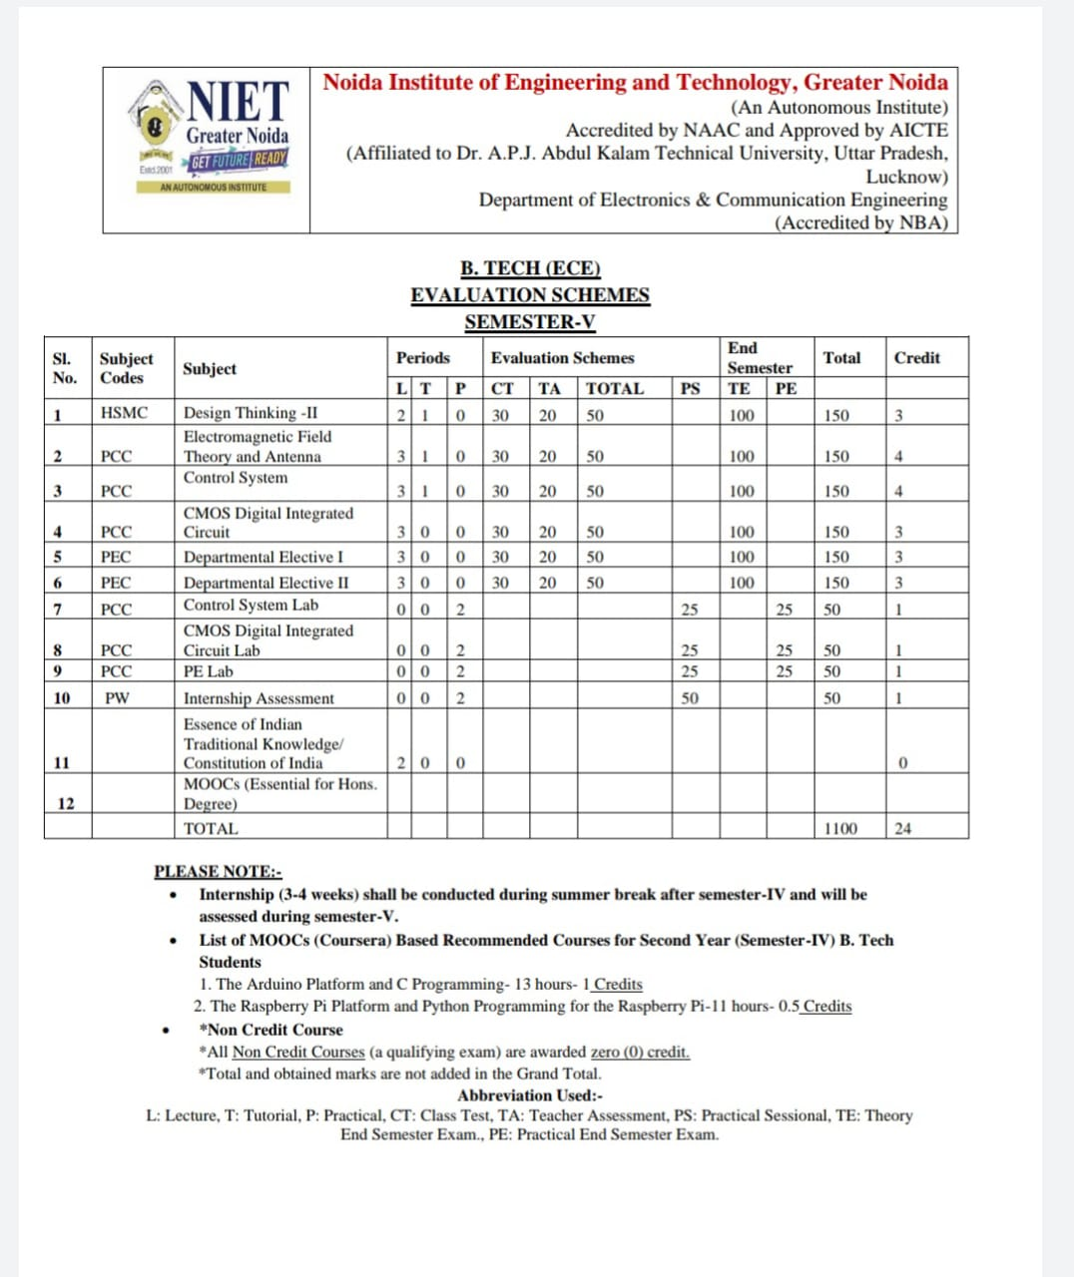
Marks Evaluation Scheme
Prof. Vikesh Shakya, Constitution of India, Law and Engineering, Unit 1

Slide 3

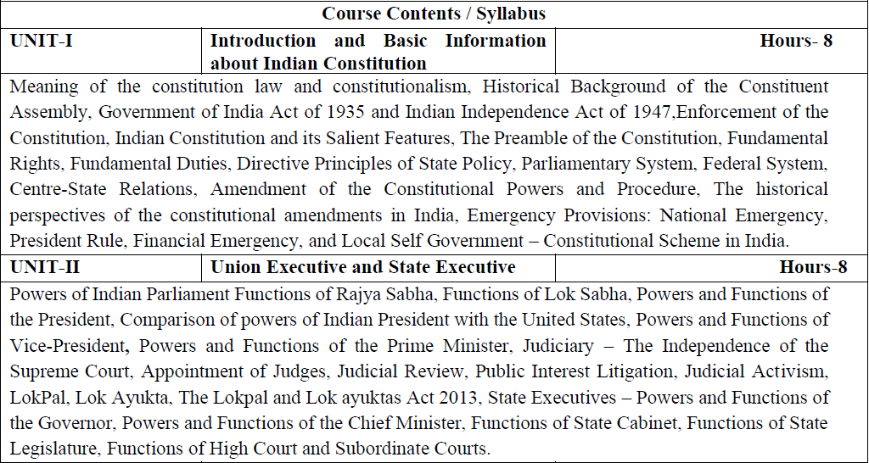
Syllabus

Slide 4
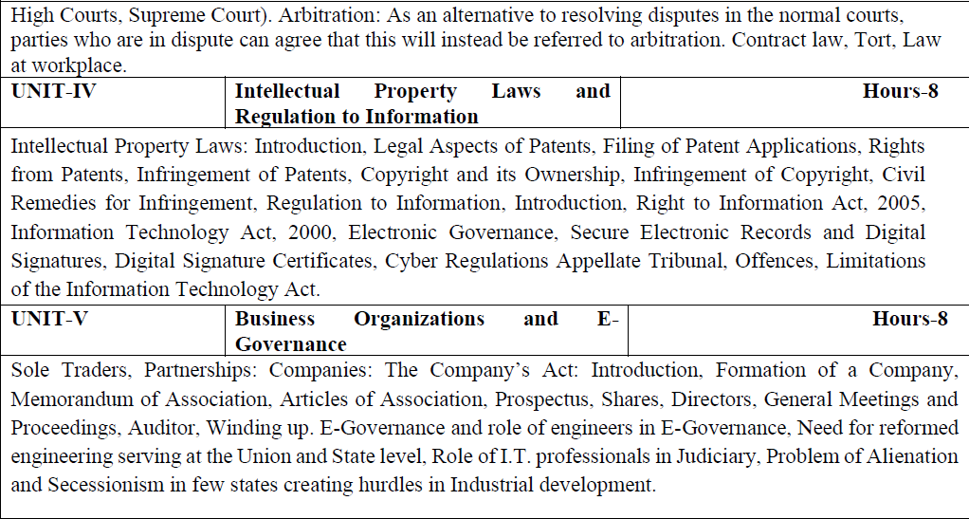
Syllabus

Slide 5

Branch wise Applications
Legal knowledge
Individual rights
Duties of a citizen
Patient filling
Business setup

Slide 6
Course Objectives
Course Objectives:
The student will try to learn about:
To acquaint the students with legacies of constitutional development in India and help those to understand the most diversified legal document of India and philosophy behind it.
To make students aware of the theoretical and functional aspects of the Indian Parliamentary System.
To channelize students’ thinking towards basic understanding of the legal concepts and its implications for engineers.
To acquaint students with latest intellectual property rights and innovation environment with related regulatory framework.
To make students learn about role of engineering in business organizations and e-governance.

Slide 7
Course Outcomes
Course Outcome:
After successful completion of the course students will demonstrate the ability to
CO1: Identify and explore the basic features and modalities about Indian constitution.
CO2: Differentiate and relate the functioning of Indian parliamentary system at the center and state level.
CO3: Differentiate different aspects of Indian Legal System and its related bodies.
CO4: Discover and apply different laws and regulations related to engineering practices.
CO5: Correlate role of engineers with different organizations and governance models
Prof. Vikesh Shakya, Constitution of India, Law and Engineering, Unit 1

Slide 8

Program Outcomes
Program Outcomes are narrow statements that describe what the students are expected to know and would be able to do upon the graduation.
These relate to the skills, knowledge, and behavior that students acquire through the programmed.
Engineering knowledge
Problem analysis
Design/development of solutions
Conduct investigations of complex problems
Modern tool usage
The engineer and society
Environment and sustainability
Ethics
Individual and team work
Communication
Project management and finance
Life-long learning

Slide 9
CO-PO Mapping
COs | POs | PO1 | PO2 | PO3 | PO4 | PO5 | PO6 | PO7 | PO8 | PO9 | PO10 | PO11 | PO12
CO1 |  | - | - | - | - | - | - | - | 3 | - | - | - | 3
CO2 |  | - | - | - | - | - | - | - | 3 | - | - | - | 3
CO3 |  | - | - | - | - | - | - | - | 3 | - | - | - | 3
CO4 |  | - | - | - | - | - | - | - | 3 | - | - | - | 3
CO5 |  | - | - | - | - | - | - | - | 3 | - | - | - | 3
Average |  | - | - | - | - | - | - | - | 3 | - | - | - | 3
Note: Correlation levels are taken 1, 2 and 3 as defined below:
1: Slight (Low) 2: Moderate (Medium) 3: Substantial (High)
If there is no correlation, put ‘-’

Slide 10
Program Specific Outcomes
Program Specific Outcomes (PSOs) are what the students should be able to do at the time of graduation. The PSOs are program specific. PSOs are written by the department offering the program.
On successful completion of B. Tech. (EC) Program, the Electronics and Communication engineering graduates will be able to:
PSO1: To apply the knowledge of mathematics, science and electronics & communication engineering to work effectively in the industry based on same or related area.
PSO2: To use their skills to work in modern electronics & communication engineering tools, software and equipments to design solutions for complex problems in the related field that meet the specified needs of the society.
PSO3: To function effectively as an individual and as a member or leader of a team by qualifying through examinations like GATE (Graduate Aptitude Test in Engineering), IES (Indian Engineering Services), PSUs (Public Sector Undertakings), TOEFL (Test of English as a Foreign Language), GMAT (Graduate Management Admission Test) and GRE (Graduate Record Examinations in US) etc.

Slide 11
CO-PSO Mapping
COs | PSOs | PSO1 | PSO2 | PSO3
CO1 |  | - | - | -
CO2 |  | - | - | -
CO3 |  | - | - | -
CO4 |  | - | - | -
CO5 |  | - | - | -
Average |  | - | - | -
Note: Correlation levels are taken 1, 2 and 3 as defined below:
1: Slight (Low) 2: Moderate (Medium) 3: Substantial (High)
If there is no correlation, put ‘-’

Slide 12
Program Educational Objectives
The Program Educational Objectives (PEOs) of an engineering degree program are the statements that describe the expected achievements of graduates in their career, and what the graduates are expected to perform and achieve during the first few years after graduation.
PEO1: To have an excellent scientific and engineering breadth so as to comprehend, analyze, design and solve real-life problems using state-of-the-art technology.
PEO2: To lead a successful career in industries or to pursue higher studies or to understand entrepreneurial endeavours.
PEO3: To effectively bridge the gap between industry and academics through effective communication skill, professional attitude and a desire to learn.

Slide 13
Result Analysis
Department wise:
Overall Clear Pass Students | 260
Overall Pass % | 92.20%
Subject wise:
Subject Code | Subject Name | Total Student | Backlog Number | Pass %
KNC501 | COILE | 282 | 0 | 100%

Slide 14
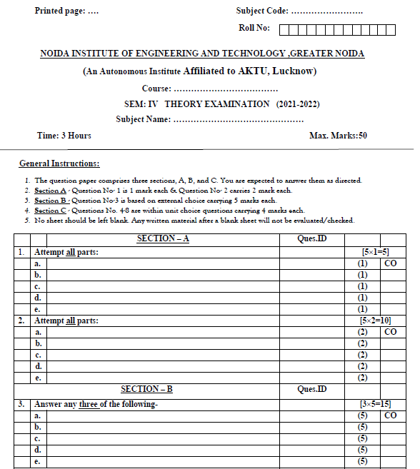
End Sem Question Paper Template

Slide 15
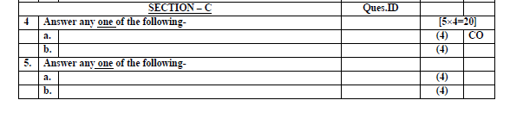
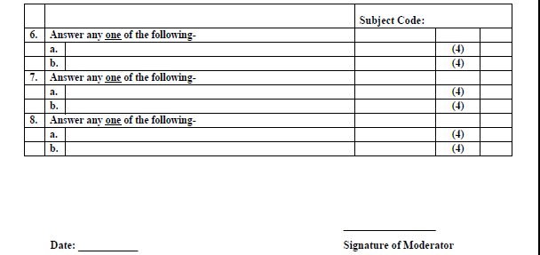
End Sem Question Paper Template

Slide 16
Prerequisite
Basic concepts of Political Science
Prof. Vikesh Shakya, Constitution of India, Law and Engineering, Unit 1

Slide 17
Brief Subject Introduction with Video
To acquaint the students with legacies of constitutional development in India and help those to understand the most diversified legal document of India and philosophy behind it. To make students aware of the theoretical and functional aspects of the Indian Parliamentary System. To channelize students’ thinking towards basic understanding of the legal concepts and its implications for engineers. To acquaint students with latest intellectual property rights and innovation environment with related regulatory framework. To make students learn about role of engineering in business organizations and e-governance.
https://www.youtube.com/watch?v=eS03-itWEPs

Slide 18
Unit Objective
To make students aware of the Constitution of India and it’s historical background.

Slide 19
Topic Objective/ Topic outcome
Name of Topic | Objective of Topic | Mapping with CO
Meaning of the constitution law and constitutionalism, Historical Background of the Constituent Assembly, Government of India Act of 1935, Indian Independence Act of 1947 and enforcement of the Constitution, Indian Constitution and its Salient Features | Students will be able to learn about Constitution. | CO1

Slide 20
Constitution
What is a Constitution?
It is a set of rules, written and unwritten, that seeks to establish the duties, powers and functions of the various institutions of government, regulate the relationships between them and define the relationships between the state and the individual.

Slide 21
Historical Background
British came to India in 1600 as a trader in the form of East India Company (EIC).
1765 – Diwani right (revenue and civil justice) – Bengal, Bihar and Orissa.
This started its career as a territorial power.
1858 – ‘Sepoy mutiny’, the British Crown assumed direct responsibility for the governance of India.
Continued until India was granted independence on Aug 15, 1947.
With Independence came the need of a Constitution.
Suggested by MN Roy in 1934.
Constituent Assembly was formed for this purpose in 1946 and on Jan 26, 1950 the Constitution came into being.

Slide 22
The Company Rule (1773-1858)
Regulation Act of 1773
First step taken by British Govt to control and regulate the affairs of EIC in India.
Recognised first time political and administrative functions of the company.
Laid the foundations of central administration in India.
Features:
Governor of Bengal became ‘Governor General of Bengal’
Bombay and Madras presidencies subordinate to the governor general of Bengal.
Created and Executive Council of four members to assist him.
Governor General – Lord Warred Hastings.

Slide 23
The Company Rule (1773-1858)
1774 – Supreme Court Calcutta comprising one Chief Justice and three judges.
Prohibited servants of company from engaging in any private trade or accepting gift or bribes.
Control of british govt over company by court of directors to report on its revenue, civil, and military affairs in India.

Slide 24

2. Pitt’s India Act of 1784
Distinguished between commercial and political functions of the company.
Court of Directors for Commercial functions and Board of Control for political affairs.
Reduced the strength of the Governor General’s council to three members.
Placed the Indian affairs under the direct control of the British Government.
The companies territories in India were called “the British possession in India”.
Governor’s councils were established in Madras and Bombay.

Slide 25
3. Charter Act of 1833
Governor-General (of Bengal) became the Governor-General of India.
First Governor-General of India was Lord William Bentick.
This was the final step towards centralization in British India.
Beginning of a Central legislature for India as the act also took away legislative powers of Bombay and Madras provinces.
The Act ended the activities of the East India Company as a commercial body and it became a purely administrative body.

Slide 26
4. Charter Act of 1853
The legislative and executive functions of the Governor-General’s Council were separated.
6 members in Central legislative council. Four out of six members were appointed by the provisional governments of Madras, Bombay, Bengal and Agra.
It introduced a system of open competition as the basis for the recruitment of civil servants of the Company (Indian Civil Service opened for all).

Slide 27
The Crown Rule (1858-1947)
Government of India Act of 1858:
The rule of Company was replaced by the rule of the Crown in India.
The powers of the British Crown were to be exercised by the Secretary of State for India
He was assisted by the Council of India, having 15 members
He was vested with complete authority and control over the Indian administration through the Viceroy as his agent
The Governor-General was made the Viceroy of India.
Lord Canning was the first Viceroy of India.
Abolished Board of Control and Court of Directors.

Slide 28
B) Indian Councils Act of 1861, 1892 and1909
Indian Councils Act of 1861:
It introduced for the first time Indian representation in the institutions like Viceroy’s executive+legislative council (non-official). 3 Indians entered the Legislative council.
Legislative councils were established in Center and provinces.
It provided that the Viceroy’s Executive Council should have some Indians as the non-official members while transacting the legislative businesses.
It accorded statutory recognition to the portfolio system.
Initiated the process of decentralisation by restoring the legislative powers to the Bombay and the Madras Provinces.

Slide 29
Continue…
India Council Act of 1892
Introduced indirect elections (nomination).
Enlarged the size of the legislative councils.
Enlarged the functions of the Legislative Councils and gave them the power of discussing the Budget and addressing questions to the Executive.

Slide 30
Continue…
Indian Councils Act of 1909
This Act is also known as the Morley- Minto Reforms.
Direct elections to legislative councils; first attempt at introducing a representative and popular element.
It changed the name of the Central Legislative Council to the Imperial Legislative Council.
The member of the Central Legislative Council was increased to 60 from 16.
Introduced a system of communal representation for Muslims by accepting the concept of ‘separate electorate’.
Indians for the first time in Viceroys executive council. (Satyendra Prasanna Sinha, as the law member)

Slide 31
Government of India Act, 1919
Government of India Act of 1919
This Act is also known as the Montague-Chelmsford Reforms.
The Central subjects were demarcated and separated from those of the Provincial subjects.
The scheme of dual governance, ‘Dyarchy’, was introduced in the Provincial subjects.
Under the dyarchy system, the provincial subjects were divided into two parts – transferred and reserved. On reserved subjects, Governor was not responsible to the Legislative council.
The Act introduced, for the first time, bicameralism at the center.
Legislative Assembly with 140 members and Legislative council with 60 members.
Direct elections.
The Act also required that the three of the six members of the Viceroy’s Executive Council (other than Commander-in-Chief) were to be Indians.
Provided for the establishment of the Public Service Commission.

Slide 32
Government of India Act, 1935
The Act provided for the establishment of an All-India Federation consisting of the Provinces and the Princely States as units, though the envisaged federation never came into being.
Three Lists: The Act divided the powers between the Centre and the units into items of three lists, namely the Federal List, the Provincial List and the Concurrent List.
The Federal List for the Centre consisted of 59 items, the Provincial List for the provinces consisted of 54 items and the Concurrent List for both consisted of 36 items
The residuary powers were vested with the Governor-General.
The Act abolished the Dyarchy in the Provinces and introduced ‘Provincial Autonomy’.
It provided for the adoption of Dyarchy at the Centre.
Introduced bicameralism in 6 out of 11 Provinces.

Slide 33
Government of India Act, 1935
These six Provinces were Assam, Bengal, Bombay, Bihar, Madras and the United Province.
Provided for the establishment of Federal Court.
Abolished the Council of India

Slide 34
Indian Independence Act, 1947
It declared India as an Independent and Sovereign State.
Established responsible Governments at both the Centre and the Provinces.
Designated the Viceroy India and the provincial Governors as the Constitutional (normal heads).
It assigned dual functions (Constituent and Legislative) to the Constituent Assembly and declared this dominion legislature as a sovereign body.

Slide 35
Constitution Assembly of India
In 1934, M N Roy first proposed the idea of a constituent assembly.
The demand was taken up by the Congress Party in 1935 as an official demand
The British accepted this in the August Offer of 1940
Under the Cabinet Mission plan of 1946, elections were held for the formation of the constituent assembly
The members of this assembly were elected indirectly, i.e., by the members of the provincial assemblies by the method of a single transferable vote of proportional representation
The constituent assembly was formed for the purpose of writing a constitution for independent India

Slide 36
Composition of the Constitution Assemble (CA)
Initially, the number of members was 389. After partition, some of the members went to Pakistan and the number came down to 299. Out of this, 229 were from the British provinces and 70 were nominated from the princely states.
Dr. Sachchidananda Sinha was the first temporary chairman of the Constituent Assembly. Later, Dr. Rajendra Prasad was elected as the President and its Vice President was Harendra Coomar Mookerjee. BN Rau was the constitutional advisor.

Slide 37
Committees of the Constituent Assembly
Drafting Committee Dr. B R Ambedkar
Union Constitution Committee Jawaharlal Nehru
Union Powers Committee Jawaharlal Nehru
States Committee Jawaharlal Nehru
Steering Committee Dr. Rajendra Prasad
Rules of Procedure Committee Dr. Rajendra Prasad
Provincial Constitution Committee Sardar Vallabhbhai Patel

Slide 38
Committees of the Constituent Assembly
Advisory Committee on Fundamental
Rights, Minorities and Tribal and
Excluded Areas: Fundamental Rights Sub- Committee: Acharya Kripalani
Minorities Sub-Committee: H C Mookerjee
Excluded and Partially Excluded Areas (Other than those in Assam) Sub-Committee: A V Thakkar
North-East Frontier Tribal Areas and Assam Excluded & Partially Excluded Areas Sub-Committee: Gopinath Bardoloi

Slide 39
Criticism of the Constituent Assembly
It was not a representative body since the members were not directly elected by adult franchise. However, the leaders did enjoy popular support from the people. Direct elections by the universal adult franchise at that time when the country was on the brink of partition and amidst communal riots would have been impractical.
It is said that the makers took a long time in framing the constitution. However, keeping in mind the complexity and the peculiarities of the diverse and large Indian nation, this can be understood.
The constituent assembly was not a sovereign body since it was created by the British. However, it worked as a fully independent and sovereign body.
The language of the constitution was criticised for being literary and complicated.
The assembly was dominated by the Congress Party. But the party dominated the provincial assemblies and this was natural. Moreover, it was a heterogeneous party with members from almost all sections of Indian society.

Slide 40
Criticism of the Constituent Assembly
It was alleged that the assembly had Hindu dominance. This was again because of proportional representation from communities.

Slide 41
Features of the Constitution
1. Lengthiest Written Constitution
2. Drawn from Various Sources
3. Blend of Rigidity and Flexibility
4. Federal System with Unitary Bias
5. Parliamentary Form of Government
6. Synthesis of Parliamentary Sovereignty and Judicial Supremacy
7. Rule Of Law
8. Integrated and Independent Judiciary

Slide 42
Features of the Constitution
9. Fundamental Rights
10. Directive Principles of State Policy
11. Fundamental Duties
12. Indian Secularism
13. Universal Adult Franchise
14. Single Citizenship
15. Independent Bodies
16. Emergency Provisions

Slide 43
Features of the Constitution
17. Three-tier Government
18. Co-operative Societies

Slide 44

Lecture Related to Topic
Constitution: https://www.youtube.com/watch?v=ZhLgAhZZpCw
Fundamental Rights: https://www.youtube.com/watch?v=pvbcJ7SkG8w
Federal System: https://www.youtube.com/watch?v=vS-NYScs0mU

Slide 45
Weekly assignment
What features of the Indian Constitution are borrowed from the USA?
What features of the Indian Constitution are borrowed from the Germany?
Write the the features of Indian Constitution.
What are the various criticism of Indian Constitution.

Slide 46
Daily Quiz
Q.1) Which of the following acts recognized for the first time, the political and administrative
functions of the East India Company?
a) Regulating Act 1773
b) Pitts India Act 1784
c) Charter Act of 1833
d) Government of India Act 1858
Q.2) Which among the following British India Acts ended the system of double government
by abolishing the Board of Control and Court of Directors?
a) Charter Act of 1853
b) Government of India Act of 1858
c) Indian Councils Act of 1861
d) Indian Councils Act of 1892

Slide 47
Daily Quiz
Q.3) Consider the following provisions under Government of India 1935 act:
1. It abolished diarchy at the center and adopted it in provinces.
2. Abolished council of India, which was established in GOI act 1858 to assist secretary of
state
3. Provided for the establishment of federal court
Which of the above statements are correct?
a) 1 and 2
b) 2 and 3
c) 1 and 3
d) All of the above

Slide 48
Daily Quiz
Q.4) With reference to the Constitution of India, consider the following statements:
1. The Constitution Day is celebrated to commemorate the commencement of
constitution.
2. Republic Day is celebrated to commemorate the adoption of constitution.
Which of the above statement is/are correct?
a) 1 only
b) 2 only
c) Both 1 and 2
d) Neither 1 nor 2

Slide 49
Daily Quiz
Q.5) Apart from the making of Constitution, which of the following functions were performed
by the Constituent Assembly?
1. Ratified India’s membership of the Commonwealth
2. Elected Dr. Rajendra Prasad as the first President of India
3. Adopted India’s National Anthem and National Song
4. Adopted the National Flag of India
Select the code from the following:
a) 1,2 and 3
b) 2,3 and 4
c) 1,3 and 4
d) All of the above

Slide 50
Daily Quiz
Q.6) Which of the following statements are correct regarding ‘Objectives Resolution’?
1. The resolution defined the aims of Constituent Assembly.
2. It was moved by Pt Nehru and adopted unanimously by INC in 1931.
3. The modified form of it forms present day Preamble of Indian Constitution.
Select the code from following:
a) 1 and 2
b) 2 and 3
c) 1 and 3
d) All of the above

Slide 51
Topic Objective/ Topic outcome
Name of Topic | Objective of Topic | Mapping with CO
The Preamble of the Constitution, Fundamental Rights, Fundamental Duties, Directive Principles of State Policy, Parliamentary System | Students will be able to learn about Preamble of the Constitution, Fundamental Rights and Duties. | CO1

Slide 52
Preamble of the Constitution
WE, THE PEOPLE OF INDIA, having solemnly resolved to constitute India into a SOVEREIGN SOCIALIST SECULAR DEMOCRATIC REPUBLIC and to secure to all its citizens:
JUSTICE, social, economic and political;
LIBERTY of thought, expression, belief, faith and worship;
EQUALITY of status and of opportunity;
and to promote among them all
FRATERNITY assuring the dignity of the individual and the unity and integrity of the Nation;
IN OUR CONSTITUENT ASSEMBLY this twenty-sixth day of November, 1949,DO HEREBY ADOPT, ENACT AND GIVE TO OURSELVES THIS CONSTITUTION.

Slide 53
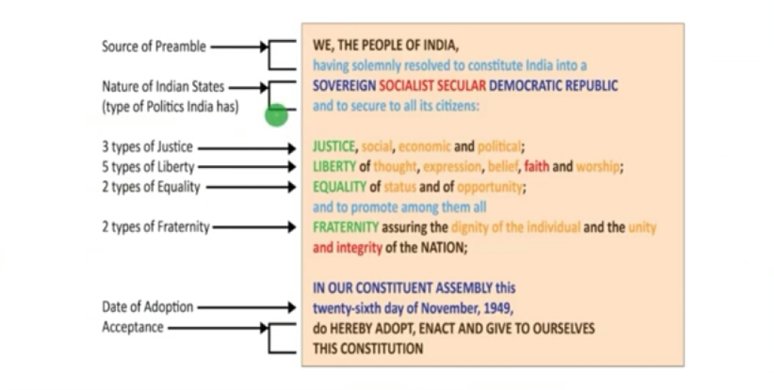
Ingredients of the Preamble

Slide 54
Fundamental Rights
Fundamental rights are the basic human rights enshrined in the Constitution of India which are guaranteed to all citizens. They are applied without discrimination on the basis of race, religion, gender, etc. Significantly, fundamental rights are enforceable by the courts, subject to certain conditions.
Articles 12-35 of Indian Constitution deal with Fundamental Rights. These human rights are conferred upon the citizens of India for the Constitution tells that these rights are inviolable. Right to Life, Right to Dignity, Right to Education etc. all come under one of the six main fundamental rights.
Why are they called Fundamental Rights?
These rights are called fundamental rights because of two reasons:
They are enshrined in the Constitution which guarantees them
They are justiciable (enforceable by courts). In case of a violation, a person can approach a court of law.

Slide 55
List of Fundamental Rights
There are six fundamental rights of Indian Constitution along with the constitutional articles related to them are mentioned below:
Right to Equality (Article 14-18)
Right to Freedom (Article 19-22)
Right against Exploitation (Article 23-24)
Right to Freedom of Religion (Article 25-28)
Cultural and Educational Rights (Article 29-30)
Right to Constitutional Remedies (Article 32)

Slide 56
List of Fundamental Rights
There are six fundamental rights of Indian Constitution along with the constitutional articles related to them are mentioned below:
Right to Equality (Article 14-18):-
Right to Freedom (Article 19-22)
Right against Exploitation (Article 23-24)
Right to Freedom of Religion (Article 25-28)
Cultural and Educational Rights (Article 29-30)
Right to Constitutional Remedies (Article 32)

Slide 57
List of Fundamental Rights
There are six fundamental rights of Indian Constitution along with the constitutional articles related to them are mentioned below:
1. Right to Equality (Article 14-18):- Right to equality guarantees equal rights for everyone, irrespective of religion, gender, caste, race or place of birth. It ensures equal employment opportunities in the government and insures against discrimination by the State in matters of employment on the basis of caste, religion, etc. This right also includes the abolition of titles as well as untouchability.
2. Right to Freedom (Articles 19 – 22)
Freedom is one of the most important ideals cherished by any democratic society. The Indian Constitution guarantees freedom to citizens. The freedom right includes many rights such as:
Freedom of speech Freedom of expression
Freedom of assembly without arms Freedom of association
Freedom to practise any profession Freedom to reside in any part of the country
Some of these rights are subject to certain conditions of state security, public morality and decency and friendly relations with foreign countries. This means that the State has the right to impose reasonable restrictions on them.

Slide 58
List of Fundamental Rights
3. Right against Exploitation (Articles 23 – 24)
This right implies the prohibition of traffic in human beings and other forms of forced labour. It also implies the prohibition of children in factories, etc. The Constitution prohibits the employment of children under 14 years in hazardous conditions.
4. Right to Freedom of Religion (Articles 25 – 28)
This indicates the secular nature of Indian polity. There is equal respect given to all religions. There is freedom of conscience, profession, practice and propagation of religion. The State has no official religion. Every person has the right to freely practice his or her faith, establish and maintain religious and charitable institutions.
5. Cultural and Educational Rights (Articles 29 – 30)
These rights protect the rights of religious, cultural and linguistic minorities, by facilitating them to preserve their heritage and culture. Educational rights are for ensuring education for everyone without any discrimination.

Slide 59
List of Fundamental Rights
6. Right to Constitutional Remedies (32 – 35)
The Constitution guarantees remedies if citizens’ fundamental rights are violated. The government cannot infringe upon or curb anyone’s rights. When these rights are violated, the aggrieved party can approach the courts. Citizens can even go directly to the Supreme Court which can issue writs for enforcing fundamental rights.
Why Right to Property is not a Fundamental Right?
There was one more fundamental right in the Constitution, i.e., the right to property.
However, this right was removed from the list of fundamental rights by the 44th Constitutional Amendment.
This was because this right proved to be a hindrance towards attaining the goal of socialism and redistributing wealth (property) equitably among the people.
Note: The right to property is now a legal right and not a fundamental right.

Slide 60
Features of Fundamental Rights
Some FRs are available only to citizens: Article 15, 16, 19, 29 and 30,
Prohibition of discrimination on grounds of race, religion, caste, gender or place of birth (Article 15).
Equality of opportunity in matters of public employment (Article 16).
Protection of freedom of:(Article 19)
Speech and expression, Association, Assembly, Movement, Residence
Profession
Protection of the culture, language and script of minorities (Article 29).
Right of minorities to establish and administer educational institutions (Article 30).
Fundamental Rights are not absolute but qualified. Reasonable restrictions can be imposed on FRs. The reasonability of such restrictions is decided by the SC.
These rights strike a balance between the rights of the individual and those of the society as a whole, between individual liberty and social control
Most rights are available against the actions of the state but some are available against the actions of the private individuals too

Slide 61
Features of Fundamental Rights
FRs are justiciable in nature
FRs are defended and guaranteed by the constitution. Hence, an aggrieved party can approach the SC for any violation directly rather than by the way of appeal
Parliament can amend the provisions of the FRs by the way of a constitutional amendment act so long as they do not violate the basic structure of the Indian constitution
FRs can be suspended during the operation of a National Emergency except the rights guaranteed by Article 20 and 21. Additionally, FRs under Article 19 can be suspended only during the operation of emergency declared on the grounds of war or external aggression
The scope of FRs is limited by Article 31A, 31B and 31C
Parliament can restrict or abrogate the application of FR in the case of armed forces, para-military forces, police forces, intelligence agencies and analogous services
FR can be restricted while martial law is in force
Only Parliament can make a law for the enforcement of the FR

Slide 62
Fundamental Duties
The fundamental duties which were added by the 42nd Amendment Act of the Constitution in 1976, in addition to creating and promoting culture, also strengthen the hands of the legislature in enforcing these duties vis-a-vis the fundamental rights.

Slide 63
List of Fundamental Duties
Abide by the Indian Constitution and respect its ideals and institutions, the National Flag and the National Anthem
Cherish and follow the noble ideals that inspired the national struggle for freedom
Uphold and protect the sovereignty, unity and integrity of India
Defend the country and render national service when called upon to do so
Promote harmony and the spirit of common brotherhood amongst all the people of India transcending religious, linguistic and regional or sectional diversities and to renounce practices derogatory to the dignity of women
Value and preserve the rich heritage of the country’s composite culture
Protect and improve the natural environment including forests, lakes, rivers and wildlife and to have compassion for living creatures
Develop scientific temper, humanism and the spirit of inquiry and reform.
Safeguard public property and to abjure violence

Slide 64
Continue…
11. Strive towards excellence in all spheres of individual and collective activity so that the nation constantly rises to higher levels of endeavour and achievement
12. Provide opportunities for education to his child or ward between the age of six and fourteen years. This duty was added by the 86th Constitutional Amendment Act, 2002

Slide 65
Directive Principles of State Policy
The framers of the constitution borrowed this idea from Irish constitution which in turn was borrowed from Spanish constitution
Dr BR Ambedkar famously remarked that DPSP are the ‘novel features’ of the Indian constitution
Granville Austin described DPSP and Fundamental Rights as the ‘Conscience of the constitution’

Slide 66
Features of DPSP
Ideals under DPSP are what state should keep in mind while formulating policies and enacting laws
DPSP resemble the ‘Instruments of Instructions’ enumerated in the Government of India Act of 1935.
DPSP are instructions to both state and legislature
DPSP embody the concept of a ‘welfare state’
DPSP are non-justiciable. Though non-justiciable, it helps the court in examining and determining the constitutional validity of a law

Slide 67
Classification of the DPSP
Constitution does not contain any classification of Directive Principles.
On the basis of their content and direction, they can be classified into three broad categories,
Socialistic,
Gandhian
Liberal-intellectual.

Slide 68
Socialist Principles:
Article 38: Promoting welfare of the society by securing a social order permeated by justice
Article 39: To secure
Right of adequate means of livelihood
Equitable distribution of material resources of the community for the common good
Prevention of concentration of wealth and means of production
Equal pay for equal work for men and women
Preservation of health and strength of workers and children against forcible abuse
Opportunities for healthy development of the child

Slide 69
Continue…
Article 39A: To promote equal justice and to provide free legal aid to the poor
Article 41: To secure the right to work, to education and to public assistance in cases of unemployment, old age, sickness and disablement
Article 42: Make provisions for just and humane conditions for work and maternity relief
Article 43: To secure a living wage, a decent standard of life and social and cultural opportunities for all workers
Article 43A: Steps to secure participation of workers in the management of industries

Slide 70
Continue…
Article 47: Raise the level of nutrition and the standard of living of people and to improve public health

Slide 71
Gandhian Principles: Gandhian Ideology
Article 40: To organize village panchayats and endow them with necessary powers
Article 43: To promote cottage industries on an individual and cooperative basis
Article 43B: To promote functioning of cooperative societies
Article 46: To promote educational and economic interests of SCs, STs and other weaker sections
Article 47: To prohibit the consumption of intoxicating drinks and drugs
Article 48: To prohibit the slaughter of cows, calves and other milch and draught cattle and to improve their breeds

Slide 72
Liberal-Intellectual Principles
Article 44: To secure a uniform civil code for all
Article 45: To provide early childhood care until 6 years of age
Article 48: To organize agriculture and animal husbandry on modern scientific lines
Article 48A: To protect and improve the environment and to safeguard forests and wildlife
Article 49: To protect monuments, places and objects of artistic or historic interest
Article 50: To separate judiciary from the executive
Article 51: To promote international peace and security

Slide 73
Parliamentary System
Parliamentary system is a form of government where executives (PM & Councils) hold the power with the majority support of the legislature (usually the people's elected house).
Our Supreme Court says that; our constitution is modeled on the British Parliamentary system where the executive is deemed to have the primary responsibility for the formation of government policy and its transmission into law by retaining the confidence of the Lok Sabha.
Article 74 and 75 provide the parliamentary system for the centre (Council of ministers & PM to advice president of india).
Article 163 and 164 provide the parliamentary system for the states (Council of ministers & CM to advice Governer).
Unlike the Presidential system, in this system, the executives sit in the legislature because they are part of the legislature.
Executives can exercise power and stay in the office as long as they have the support of the lower house of the legislature.

Slide 74
Continue…
In India, the Council of Ministers is collectively responsible to the Lok Sabha.
The collective responsibility means the council of ministers has joint responsibility for their actions towards Lok Sabha. Even if a decision has been taken by a single minister, under the principle of collective responsibility the whole council of ministers has responsibility for it.

Slide 75
Features or Principles of Parliamentary Government
Nominal and real executives
Collective responsibility
Political homogeneity
Dual membership
Secrecy

Slide 76
Lecture Related to Topic
Parliamentary system: https://www.youtube.com/watch?v=8yFk2aQamXg
Directive Principles of State Policy: https://www.youtube.com/watch?v=Id_Chh5y8Zc

Slide 77
Weekly assignment
What are the various fundamental rights available to the citizen of India?
Explain various Fundamental duties of Indian citizens.
Fundamental duties have been added to the constitution in accordance with the recommendation of?
The Directive Principles resemble the ‘Instrument of Instructions’ enumerated in which Act?
What is the difference between fundamental rights and rights secured by other provisions of the Constitution?

Slide 78
Daily Quiz
Q.1) Consider the following statements regarding the Preamble of Indian Constitution:
1. In Keshavananda Bharti case, Supreme Court held that Preamble is not a part of the Constitution.
2. The Preamble is neither a source of power to legislature nor a prohibition upon the powers of legislature.
3. It is justiciable, that is, its provisions are enforceable in courts of law.
Which of the above statements are correct?
a) 1 and 2
b) 2 and 3
c) 1 and 3
d) All of the above

Slide 79
Daily Quiz
Q.2) Which of the following statements is/are true in regard to the Preamble of India?
1. The term ‘justice’ in the Preamble embraces social, economic and political justice.
2. The ideal of justice – social, economic and political – in our Preamble has been taken
from the American Revolution.
3. The ideals of liberty, equality and fraternity in our Preamble have been taken from the
French Revolution.
Select the appropriate code:
a) 1 and 2 only
b) 1 and 3 only
c) 2 and 3 only
d) All of the above

Slide 80
Daily Quiz
Q.3) The ‘Fraternity’ mentioned in the preamble refers to the common brotherhood of all citizens. The constitution promotes fraternity through which of the following?
1. Single citizenship
2. Fundamental rights
3. Fundamental duties
4. Directive principles of state policy
Select the correct answer using the codes below.
a) 1 only
b) 2 and 3 only
c) 1 and 3 only
d) 1, 2 and 3 only

Slide 81
Daily Quiz
Q.4) Consider the following statements about the Preamble of the Constitution.
1. It is not justiciable in nature.
2. It cannot be amended.
3. It can override specific provisions of the constitution.
4. It has been a source of power to the executive.
Select the correct answer using the codes below.
a) 1 only
b) 2 and 3 only
c) 1 and 3 only
d) All the above

Slide 82
Daily Quiz
Q.5) The Preamble reveals which among the following ingredients or components -
1. Source of authority of the Constitution
2. Nature of Indian State
3. Objectives of the Constitution
4. Date of adoption of the Constitution
Choose correct option:
a) 2 and 3 only
b) 2, 3 and 4 only
c) 1, 3 and 4
d) 1, 2, 3 and 4

Slide 83
Topic Objective/ Topic outcome
Name of Topic | Objective of Topic | Mapping with CO
Federal System, Centre-State Relations, Amendment of the Constitutional Powers and Procedure, The historical perspectives of the constitutional amendments in India | Students will be able to learn about Federal system and constitutional amendments. | CO1

Slide 84
Federal System
Federalism is a system of government in which powers have been divided between the centre and its constituent parts such as states or provinces. It is an institutional mechanism to accommodate two sets of politics, one at the centre or national level and second at the regional or provincial level.
In a federation system, there are two seats of power that are autonomous in their own spheres. A federal system is different from a unitary system in that sovereignty is constitutionally split between two territorial levels so that each level can act independently of each other in some areas.

Slide 85
Continue…
There are two kinds of federations:
Holding Together Federation – In this type, powers are shared between various constituent parts to accommodate the diversity in the whole entity. Here, powers are generally tilted towards the central authority. Example: India, Spain, Belgium.
Coming Together Federation – In this type, independent states come together to form a larger unit. Here, states enjoy more autonomy as compared to the holding together kind of federation. Example: USA, Australia, Switzerland.

Slide 86
Federal features of the constitution of India
Written Constitution
Supremacy of the Constitution
Bicameralism- (Dual government polity)
Division of powers between various levels
Rigidity of constitution
Independence judiciary
All federations might not have all the above features. Some of them may be incorporated depending on what type of federation it is.

Slide 87
Unitary or Non-Federal features
The flexibility of the constitution
More power vests with the Centre
Unequal representation of states in the Rajya Sabha
The executive is a part of the legislature
Lok Sabha is more powerful than the Rajya Sabha
Emergency powers (national emergency, state emergency, and financial emergency)
Integrated judiciary
Single citizenship
Governor’s appointment
New states formation
All India Services
Integrated election machinery
Veto over states bills
Integrated audit machinery (Auditor-General of India )

Slide 88
Centre-State Relations
The constitution of India divides all powers- legislative, executive and financial between the centre and the states
Maximum harmony and coordination centre and state is essential for the effective operation of the federal system. Thereby, the constitution incorporates several provisions to ensure this.
Centre-state relations can be better understood under the following three heads:
Legislative relations
Administrative relations
Financial relations

Slide 89
Legislative Relations
There are four aspects in the Centre-state legislative relations:
Territorial extent of central and state legislation- (Parliament & State legislature)
Distribution of legislative subjects
Parliamentary legislation in the state field
Centre’s control over state legislation

Slide 90
Continue…
Territorial extent of central and state legislation
Parliament can make law for the whole or any part of the territory of India (territory includes union, state, UT)
State legislature can make laws for the whole or any part of the state. Laws made by the state are not applicable outside the state, except when there is sufficient relation between the state and object
Parliament can alone make ‘extra-territorial’ legislation
President can make regulations which has a same effect as that of the law made by parliament for- Andaman and Nicobar islands, Daman and Diu, Dadra and Nagar Haveli and Lakshadweep
Governor is empowered to direct that an act of parliament does not apply to a scheduled area in the state or apply with specified modifications and exceptions

Slide 91
Continue…
Governor of Assam can likewise direct that an act of Parliament does not apply or apply with some modification. The same power is vested in President in relation to Meghalaya, Tripura and Mizoram

Slide 92
Distribution of Legislative subjects
Constitution provides for three-fold classification- union list, state list and concurrent list
Parliament has exclusive powers in relation to the union list
State legislature in normal circumstances has exclusive powers to make laws with matters enumerated in the state list
Both state and centre can make laws on matters enumerated in the concurrent list
Power to make laws with residuary subject is vested in the Parliament
Union list has precedence over state list and concurrent list has precedence over state list
In case of conflict between central law and state law on a subject enumerated in the concurrent list, the central law prevails over the state law. However, if the state law has been reserved for the consideration of the president and has received his assent, then the state law prevails in the state. Still, parliament can override the state law by subsequently making a law on that matter.

Slide 93
Administrative Relations
The executive power has been divided between the centre and the states on the lines of distribution of legislative powers
The power of the centre extends to the whole of India on matters where it has exclusive jurisdiction (union list) and to the exercise of rights, authority and jurisdiction conferred on it by any treaty or agreement
The jurisdiction of the state extends to those matters enumerated in the state list
In matters related to concurrent list, the executive power rests with the states

Slide 94
Financial Relations
Allocation of taxing powers (Union, State, Concurrent & Residuary power of taxation
Restriction placed by constitution on taxation power of the state
A state legislature can impose taxes on profession, trades, callings and employments. But, the total amount payable by any person should not exceed Rs 2500 per annum
A state can impose taxes on sale or purchase of goods (other than newspaper). But, this power of state to impose sales tax is subjected to four restrictions:
No tax can be imposed n the sale or purchase of taking place outside the states, in the course of import or export, inter-state trade and commerce
A tax imposed on the sale or purchase of goods declared by the Parliament to be of special importance in inter-state trade and commerce is subject to the restrictions and conditions specified by the Parliament
A state can impose tax on sale of water or electricity sold to an authority established by Parliament for regulating or developing Inter-state River. However, such imposition can be undertaken through a law which has received the assent of the President

Slide 95
Financial Relations
Distribution of tax revenues
Distribution of Non-tax revenues:
The Centre: The receipts from the following form the major sources of non-tax revenues of the centre: i) posts and telegraphs; ii) railways; iii) banking; iv) broadcasting; v) coinage and currency; vi) central public sector enterprise.
The states: The receipts from the following form the major sources of non-tax revenues of the states: i) irrigation; ii) forests; iii) fisheries; iv) state public sector enterprise
Grants-in-Aid to the states:-
Statutory grants: Article 275 empowers the parliament to make grants to the states which are in need of financial assistance and not to every state, These sums can be different for different states. These sums are charged on the Consolidated Fund of India every year, These are given to the states based on the recommendation of the Finance Commission
Discretionary grants: Article 282 empowers both the centre and the states to make any grants for any public purpose, even if it is not within their legislative competence.
Finance Commission

Slide 96
Amendment of the Constitution
Making changes to the constitution, which is the governing law of the land, is known as a constitutional amendment.
Changing or altering the constitution necessitates a formal modification to the written text of the country's constitution. It entails the addition of a new article or clause, the deletion of an existing article or clause, or the improvement of existing articles.
The text of the constitution has also been modified in other areas. The constitution's amendment requires it to go through a specific procedure, which includes passing it via multiple legislative assemblies before being sent to the president for final approval and signature.

Slide 97
Procedure for Amendment
Part XX, Article 368, deals with Parliament's power to modify the Constitution and the procedure for doing so. It keeps the Indian Parliament's arbitrary power under check.
Article 368 of the Constitution sets forth the mechanism for amending the Constitution, which states that an amendment can only be commenced by introducing a Bill in either House of Parliament, which must be passed by both.
The Bill must be passed by both houses with a total majority (regardless of vacancies or absentees) and a majority of not less than 2/3rds of those present and voting.
In the event of modifications, there is no provision for a joint sitting.
It must be ratified by not less than half of the states in order to alter provisions stated in Article 368, such as amending federal features.

Slide 98
Types of Amendments
The Constitution can be amended in one of three ways:
Amendment by a simple majority of the Parliament
Amendment by a special majority of the Parliament
Amendment by a special majority of the Parliament and at least half of the state legislatures' ratification

Slide 99
Lecture Related to Topic
Amendments: https://www.youtube.com/watch?v=WDcAh2vfsdc
Centre-State relations: https://www.youtube.com/watch?v=gzLNRXyQAqg

Slide 100
Weekly assignment
Write the various characteristics of federal government?
Write the features of the Presidential form of government?
How many countries have the federal form of government?
What is a Kitchen Cabinet?
Write the feature of the Parliamentary form of government?

Slide 101
Daily Quiz
Q.1) Which of the below given Directive Principles are part of Gandhian ideology?
1. To make provision for just and humane conditions for work and maternity relief.
2. To promote equal justice and to provide free legal aid to the poor.
3. To prohibit the consumption of intoxicating drinks and drugs which are injurious to health.
4. To prohibit the slaughter of cows, calves and other milch and draught cattle and to improve their breeds.
Choose the correct answer:
a) 1 and 3
b) 3 and 4
c) 1, 3 and 4
d) 2, 3 and 4

Slide 102
Daily Quiz
Q.2) Which among the following Directive Principles were added later and was not part of the original list?
1. State shall secure opportunities for healthy development of children.
2. State shall take steps to secure the participation of workers in the management of industries.
3. State shall take steps to protect and improve the environment and to safeguard forests and wildlife.
Choose correct answer:
a) 3 only
b) 1 only
c) 1 and 3 only
d) 1, 2 and 3

Slide 103
Daily Quiz
Q.3) Fundamental Duties of India are inspired by which of the following Constitutions?
a) Weimar Constitution of Germany
b) Erstwhile USSR
c) South Africa
d) Ireland
Q.4) The provision which says – “to renounce practices derogatory to the dignity of women” in Indian Constitution is provided in
a) Preamble
b) Fundamental Rights
c) Fundamental Duties
d) DPSPs

Slide 104
Daily Quiz
Q.5) Consider the following statements about Fundamental Duties.
1. Fundamental duties in Part IV A of constitution are confined only to citizens and not extended to foreigners.
2. Constitution contains duties of citizens and not the duties of state.
Which of the above statements is/are correct?
a) 1 only
b) 2 only
c) Both 1 and 2
d) None

Slide 105
Daily Quiz
Q.6) Consider the following statements about Directive Principles of State Policy:
1. The Directive Principles resemble the ‘Objective Resolutions’ which was moved by Nehru in 1946.
2. They lay down the foundation stone of social equality and social justice.
3. DPSP consists of certain rights that individuals should enjoy apart from the Fundamental Rights.
Select the correct answer:
a) 2 only
b) 3 only
c) 1 and 3 only
d) 1, 2 and 3

Slide 106
Topic Objective/ Topic outcome
Name of Topic | Objective of Topic | Mapping with CO
Emergency Provisions: National Emergency, President Rule, Financial Emergency, and Local Self Government – Constitutional Scheme in India | Students will be able to learn about Emergency provisions. | CO1

Slide 107
Emergency Provisions
Emergency in the Indian Constitution can be differentiated as National Emergencies, State Emergencies, and Financial Emergencies. Part XVIII of the Constitution contains the emergency provisions in India.

Slide 108
Continue…
Article 352 demarcates the National Emergency: According to Article 352, the President may declare an emergency when the region is under a state of attack, external intrusion, or internal rebellion. Though such a declaration could only be made in the presence of the legislative house and further supported by each chamber, the emergency was withdrawn after a month of announcement.
The first emergency in the Nation was declared during the war with China, which lasted between 1962 and 1968. After that, the most contentious emergency was declared due to internal conflict by Smt. Indira Gandhi.

Slide 109
Continue…
State Emergency has been included in Article 356: Article 356 marks out that the President can declare a state emergency on receipt of briefs by the Governor of a particular state or by the President’s observation on degrading mechanisms of the state. Thirty-five instances of President rule have been recorded under the rule of Smt. Indira Gandhi.

Slide 110
Continue…
Financial Emergencies are in Article 360: The President can declare financial emergencies if convincing evidence of an unstable economy and credibility is encountered. Executive and legislative factors play a central role in declaring a financial emergency. According to Article 360, a corresponding proclamation will be withheld during the entire emergency period. Financial emergency has never been declared in India.

Slide 111
Continue…
The 44th Amendment changed the picture of emergency provisions in the Indian Constitution that restricted the executive’s unjust influence as previously done in 1975. The “internal disturbance” is replaced by “armed rebellion.” It is also clearly stated that direct communication between cabinets must occur to declare an emergency. Moreover, the residents should be re-approved every six months to proceed with the emergency. Finally, the state of emergency can be annulled by a simple majority of the Houses.

Slide 112
Lecture Related to Topic
Emergency Provisions: https://www.youtube.com/watch?v=JkO6N9psY3w

Slide 113
Weekly assignment
To date how many times the Financial Emergency has been proclaimed in India?
Emergency Provisions in the Indian Constitution are derived from the Constitution of which country?
What are the various features of Financial Emergency.
What is National Emergency?

Slide 114
Daily Quiz
1.Who among the following was the chairperson of the Provincial Constitution Committee of the Constituent Assembly?
[A] Jawaharlal Nehru [B] Sardar Vallabhbhai Patel [C] Dr. B.R. Ambedkar [D] J.B. Kripalani
2.Which of the following committee made a recommendation that election commission should be a three member body ?
[A] Tarkunde Committee [B] Ashok Mehta Committee [C] Jeevan Reddy Committee [D] JP Committee

Slide 115
Daily Quiz
4.Which among the following article is specifically excluded from the purview of the procedure of amendment as prescribed in Article 368?
[A] Article 54 [B] Article 154 [C] Article 169 [D] Article 214
5.In which year Sikkim was included in the North Eastern Council ?
[A] 1992 [B] 1999 [C] 2002 [D] 2005

Slide 116
Daily Quiz
7.Which act provided some share to Indians in the administration of their county?
[A] Regulating Act, 1773 [B] Pitts India Act, 1784 [C] Charter Act of 1833 [D] Charter Act 1813
8. In which year was Goa was conferred statehood?
[A] 1967 [B] 1987 [C] 1995 [D] 1992

Slide 117
Daily Quiz
10.Which of the following Article prohibits the employment of children in factories and hazardous industries?
[A] Article 22 [B] Article 23 [C] Article 24 [D] Article 25
11.Which article of the Indian Constitution includes the Doctrine of Due Process of Law is included?
[A] Article 16 [B] Article 26 [C] Article 21 [D] Article 11

Slide 118

YouTube & NPTEL Video Links
YouTube/other Video Links
https://www.youtube.com/watch?v=0YZlLQPu4vY
https://www.youtube.com/watch?v=s62SQtPE3bM
https://www.youtube.com/watch?v=LYHAy68pQWA
https://www.youtube.com/watch?v=jN_IVXQr3DQ
https://www.youtube.com/watch?v=SOT4q7XWfFg
https://www.youtube.com/watch?v=4y1kIx2P4xg
https://www.youtube.com/watch?v=ltuNMXble60

Slide 119
MCQs
Which article empowers the president to proclaim a National Emergency?
A. Article 352
B. Article 355
C. Article 358
D. Article 360
Which article empowers the president to proclaim a financial Emergency?
A. Article 352
B. Article 355
C. Article 358
D. Article 360

Slide 120
MCQs
Election of the President and its manner are amended through
A. the simple majority of parliament
B. the special majority of parliament
C. the special majority of parliament and consent of States
D. None of the above
Fundamental rights are amended through
A. the simple majority of parliament
B. the special majority of parliament
C. the special majority of parliament and consent of States
D. None of the above

Slide 121
MCQs
_____ was the first president of India.
A. Dr. Rajendra Prasad
B. H.V.R Iyengar
C. Dr. Sachchidananda Sinha
D. S.N. Mukerji
Which Act mentioned the Governor General of Bengal became the Governor General of India.
A. Regulating Act of 1773
B. Pitt’s India Act of 1784
C. Charter Act of 1833
D. Charter Act of 1853

Slide 122
MCQs
How many members can be nominated to the Rajya Sabha by president of India ?
A. 10
B. 12
C. 14
D. 18
Who of the following is the chairman of the National Water resources council ?
A. Prime Minister of India
B. Union Minister of Water resources
C. Union minister of agriculture
D. Union Minister of earth sciences

Slide 123
MCQs
Which one is known as Lower House ?
A. Lok Sabha
B. Rajya sabha
C. Vidhan Sabha
D. Vidhan Parishad
Under whose direct supervision is the Lok sabha secretariat ?
A. Cabinet Secretary
B. Ministry of Parliament affairs
C. Speaker of Lok sabha
D. Prime Minister of India

Slide 124

Glossary Questions
Pick the correct answer from given Glossary:
1. A written document in which we find rules formulated through consensus is called a ________.
2. The constitution of a country tells us the _____ of the society of that country.
3. The most important Fundamental Right guaranteed by the Indian Constitution is the _____.
4. According to the Right_______ human trafficking, forced labour and children working under 14 years of age is prohibited.
Constitution | Fundamental nature | Right to equality | Right against exploitation

Slide 125
Weekly Assignment
Describe the key features Government of India Act of 1935 (CO1)
Describe key features of Indian Independence Act of 1947. (CO1)
Describe the Indian Constitution and its salient features. (CO1)
Explain the Preamble of the constitution. (CO1)
Explain various fundamental rights available to the citizen of India. (CO1)
Explain various fundamental duties of the citizen of india. (CO1)
Explain various emergency provisions. (CO1)

Slide 126
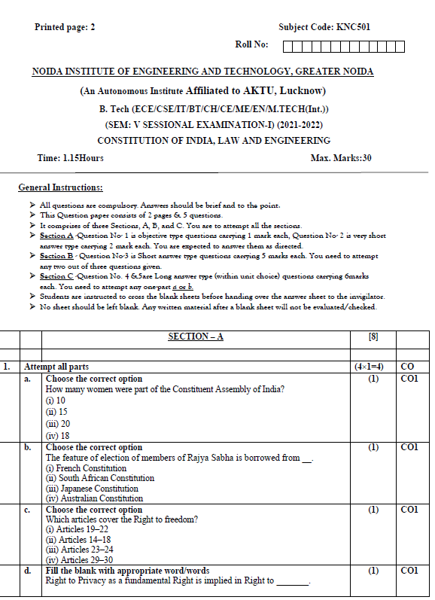
Sessional paper - I

Slide 127
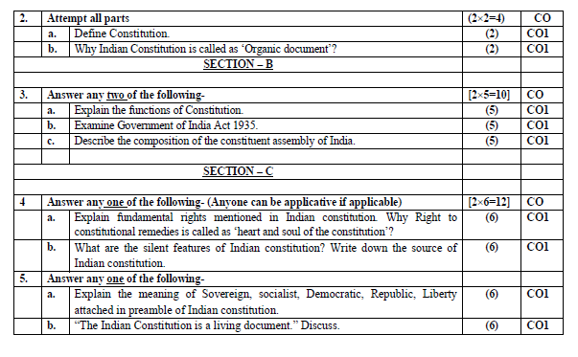
Sessional paper - I

Slide 128
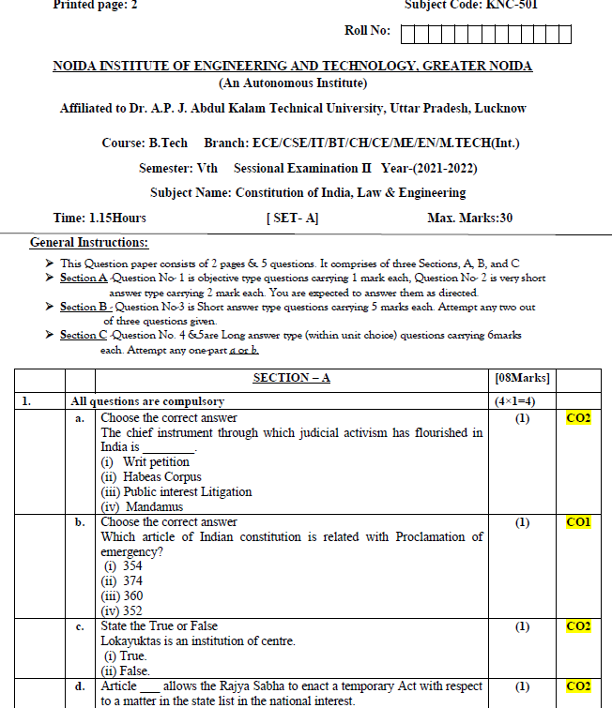
Sessional paper -II

Slide 129
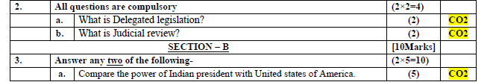
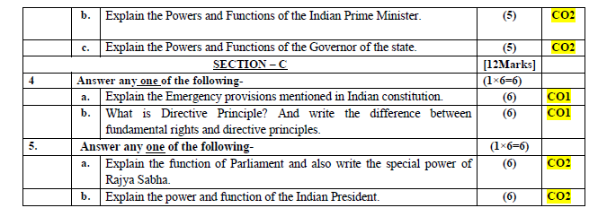
Sessional paper -II

Slide 130
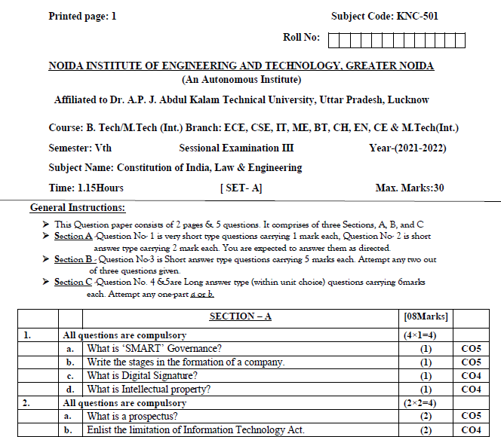
Sessional paper -III

Slide 131
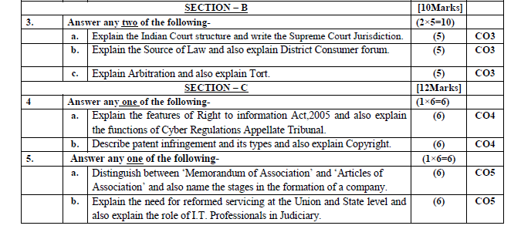
Sessional paper -III

Slide 132
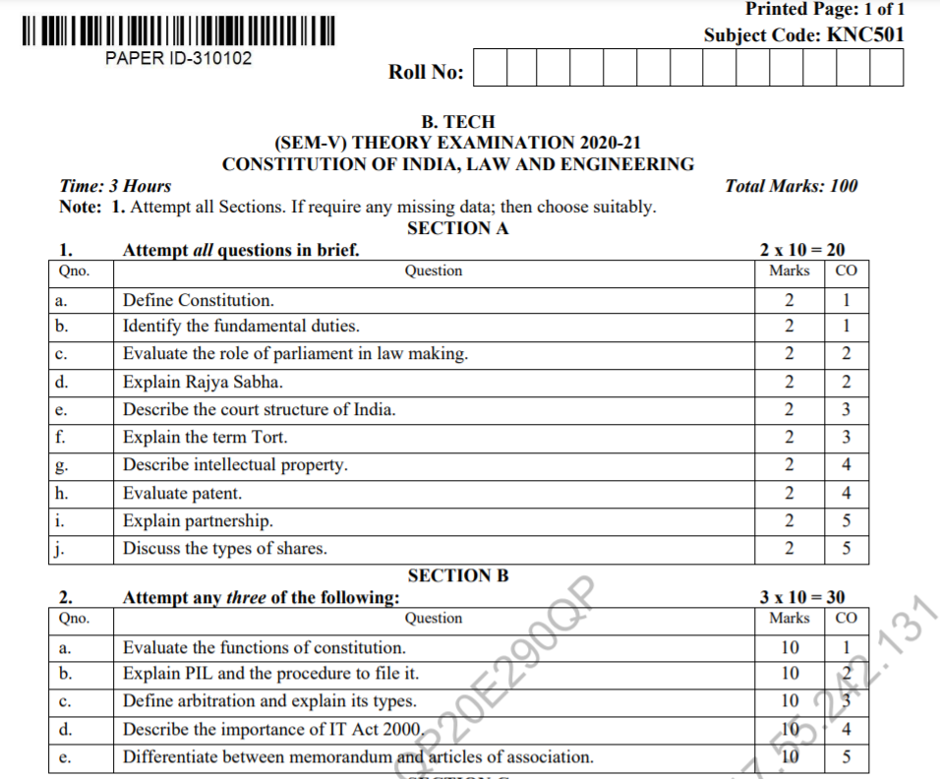
Old Question Papers

Slide 133
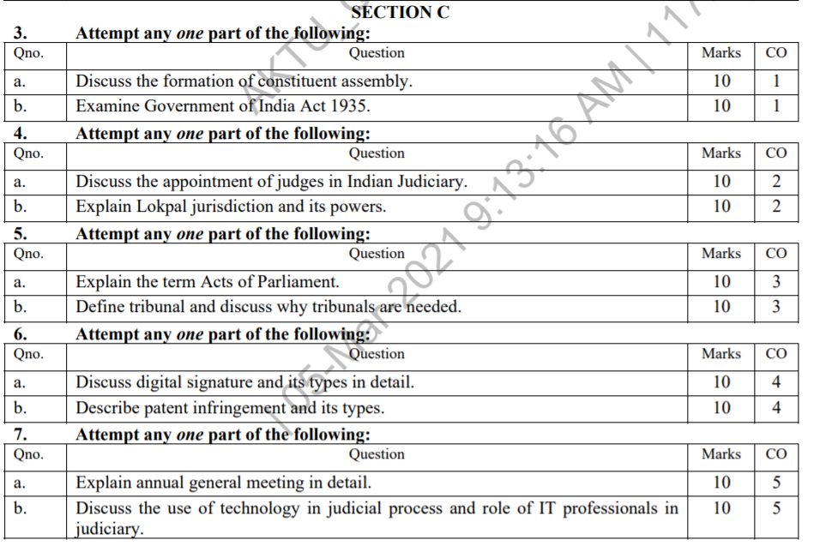
Old Question Papers

Slide 134
Expected Questions for University Exam
What are the salient features of India Independence Act, 1947?
What are the salient features of Pitts India Act 1784.
What are the salient features of Regulating Act 1773?
On whose recommendations the members of the Council of Ministers appointed?
What is the procedure of removal of the President known as?
How many members of the Rajya Sabha are nominated by the President?
Explain Charter Act of 1833?
Explain Charter Act of 1853?
Explain Government of India Act 1919.
Explain Government of India Act 1935.

Slide 135
Expected Questions for University Exam
Compare the pardon powers of Indian President and the Governor.
Write a short note on the constitution assemble of India.
Write a brief note on objective resolution that is passed by constitution assembly.
What are the various criticism of constitution assemble.
What is Lokpal? Describe the structure of Lokpal.
What are the various Directive Principles of State Policy.
Explain the powers and functions of the Chief Minister?
What are the powers and functions of State Legislature?

Slide 136
Recap
Meaning of the constitution law and constitutionalism
Historical Background of the Constituent Assembly
Government of India Act of 1935
Indian Independence Act of 1947
Indian Constitution and its Salient Features
The Preamble of the Constitution
Fundamental Rights, Fundamental Duties, DPSP
Parliamentary System
Centre-State Relations
Amendment of the Constitutional Powers and Procedure
Emergency Provisions: National Emergency, President Rule, Financial Emergency,

Slide 137
References
Indian Polity by Laxmikant
Madhav Khosla: The Indian Constitution, Oxford University Press.
PM Bakshi: The Constitution of India, Latest Edition, Universal Law Publishing.
V.K. Ahuja: Law Relating to Intellectual Property Rights (2007)

Slide 138
Thank You

